Slide 1
Designing for Dyslexia
Ervin Lin
Javier Coyoc
Web Dev Masters
Alfred Acosta

Slide 2
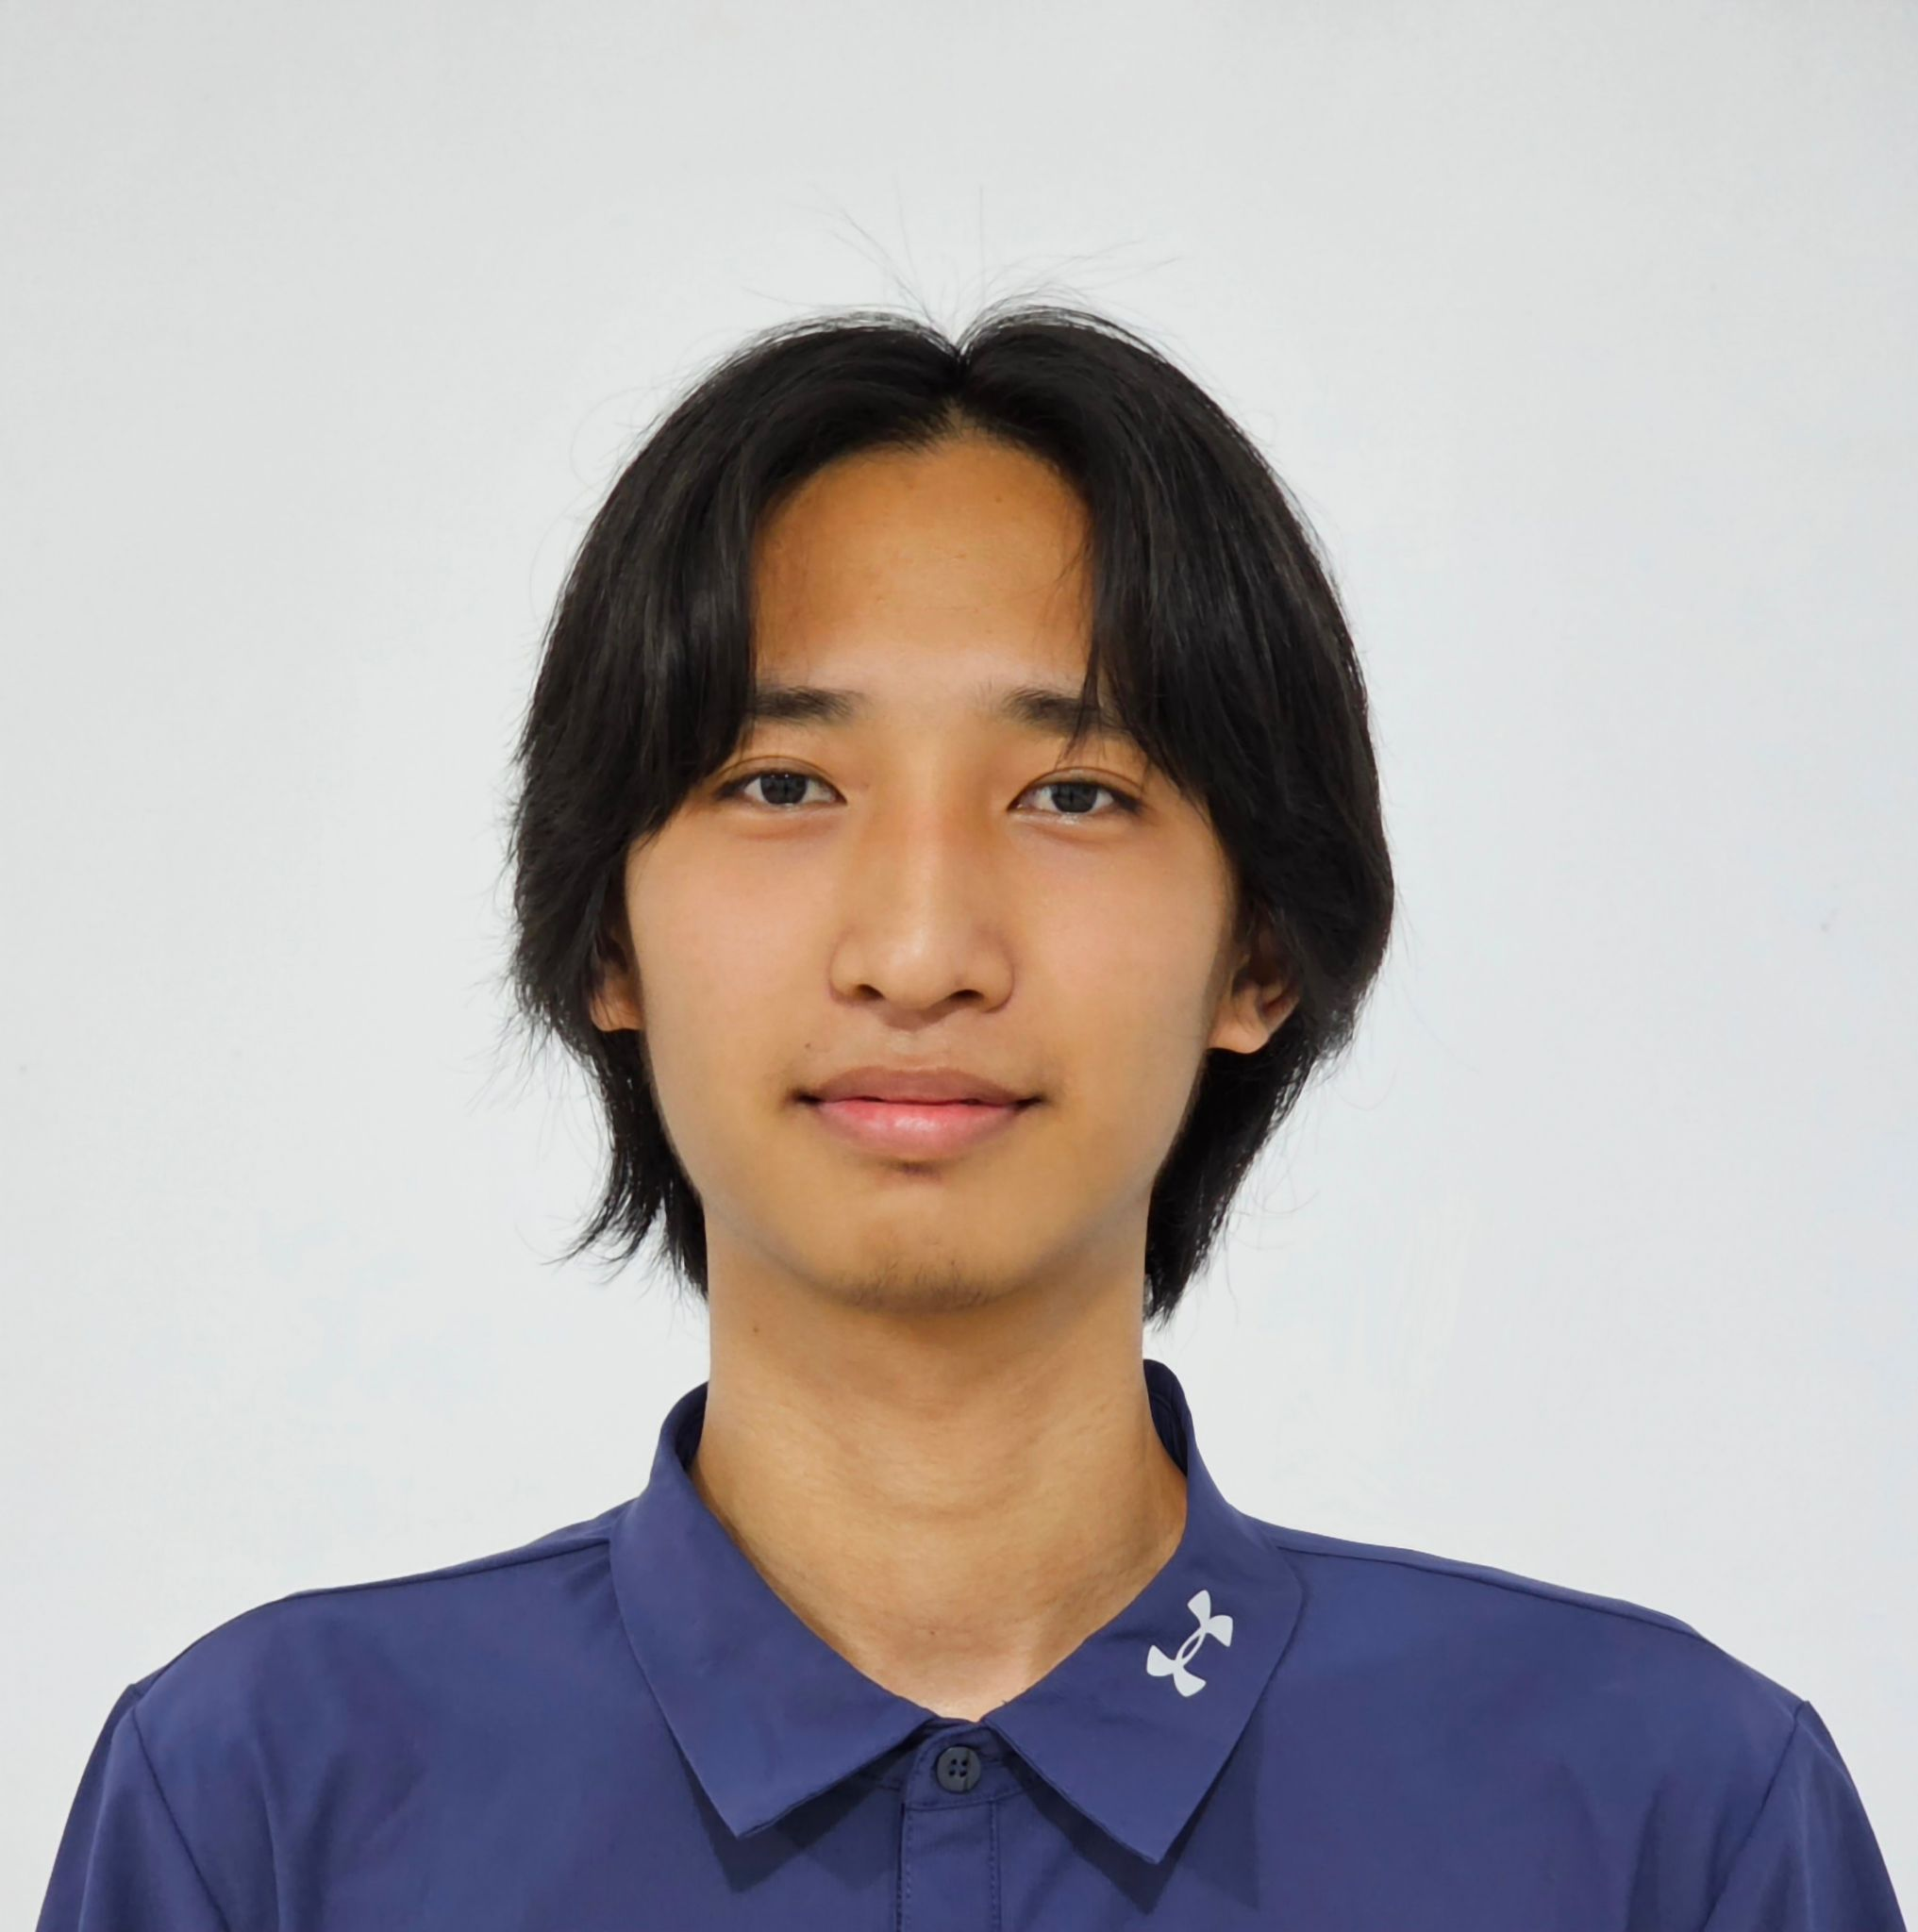
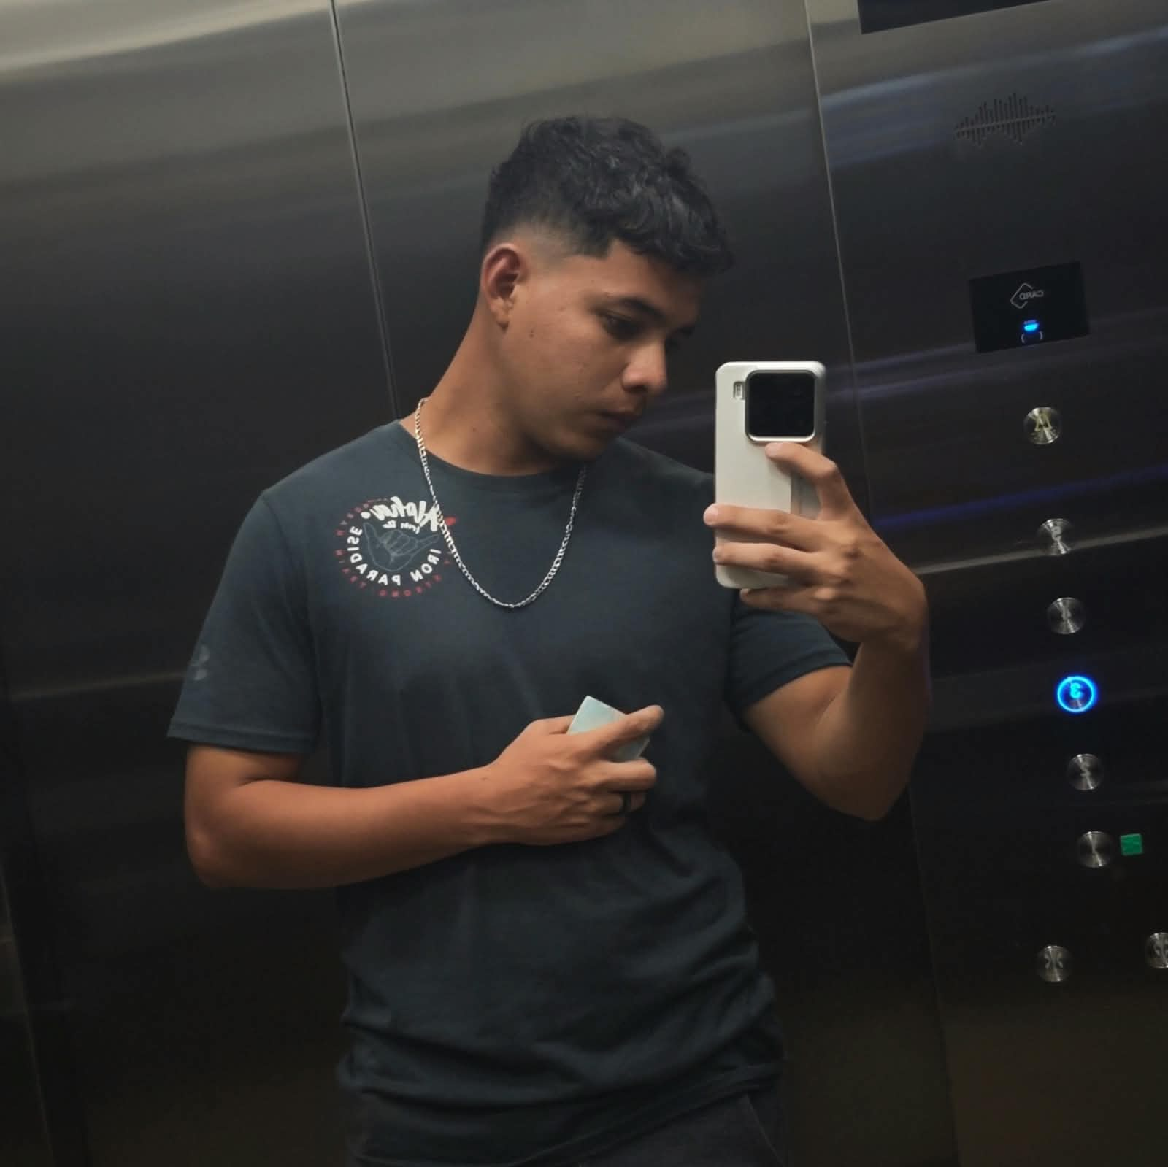
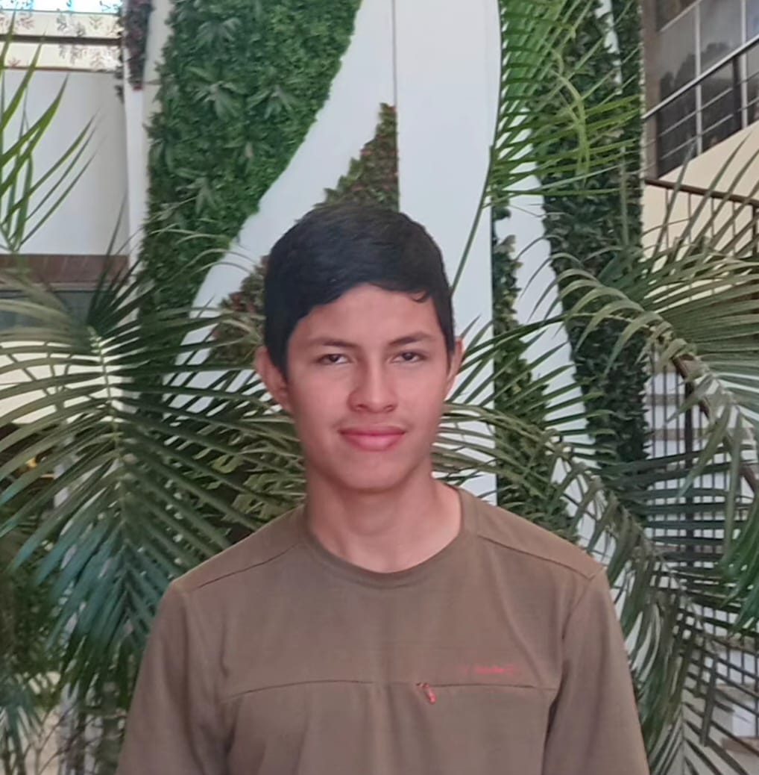
MEET THE TEAM
Ervin Lin
Alfred Acosta
Javier Coyoc

Slide 3
Initial POV
> We met high school teachers who design online reading materials, but struggle to understand how text layout affects dyslexic students, leaving them unsure of how to format content accessible.
> We met a highschool student with dyslexia who gets overwhelmed by dense web pages, needing customized text spacing and font adjustments so they can read without mental fatigue.

Slide 4
Additional Needfinding Results

Slide 5

Mr. Alfredo Acosta
Clear visual guidance on how layout choices impact readability for dyslexic students.
Teacher/Principal

Slide 6

Mrs. Lucia Coyoc
A fast, visual way to demonstrate accessibility concepts without taking time to learn complex guidelines.
Teacher

Slide 7
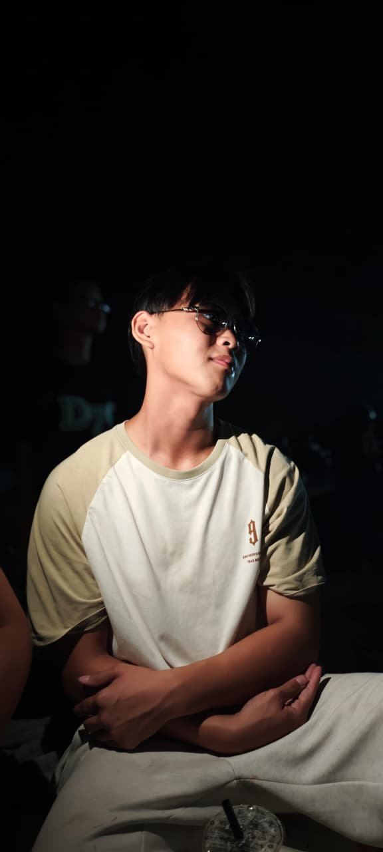
Jack Zhu
A floating control wheel lets them toggle font sizes, line spacing, and color tints on a sample page to immediately see the difference.
Student

Slide 8
Revised POV - Principal / Teacher
Mr. Alfredo Acosta, a teacher and principal who wants to make online learning materials more accessible for students with dyslexia.
01.
We met:
how difficult it can be for teachers to know which text formatting choices, such as font size, spacing, and layout, will actually improve readability.
02.
We discovered:
provide teachers with a simple visual way to apply dyslexia-friendly formatting while creating online learning materials.
03.
It would be beneficial to:

Slide 9

Revised POV - Teacher
Mrs. Lucia Coyoc, a teacher who wants to create accessible content without having to spend a lot of time learning complex accessibility guidelines.
01.
We met:
that teachers need a fast and visual way to understand how different formatting choices affect readability.
02.
We discovered:
teachers could instantly preview and apply accessible formatting options while designing their lessons.
03.
It would be beneficial to:

Slide 10
Revised POV - Student
Jack Zhu, a student with dyslexia who reads online materials and needs greater control over how text is displayed.
01.
We met:
that students benefit from being able to adjust text size, spacing, and background settings to make reading more comfortable.
02.
We discovered:
give students a simple one-click tool that lets them customize online text into a dyslexia-friendly view.
03.
It would be beneficial to:

Slide 11
POV #1
POV #2
Top 3
HWMs
POV #3
How might we make text formatting choices (like font, line spacing, and column width) be used by teachers as they design online materials?
How might we enable students to toggle their peer's shared notes into a dyslexia-friendly view with a single click?
How might we allow dyslexic students to dynamically customize text spacing, font styles, and layout density on any web page so reading feels effortless?

Slide 12
Prototypes

Slide 13
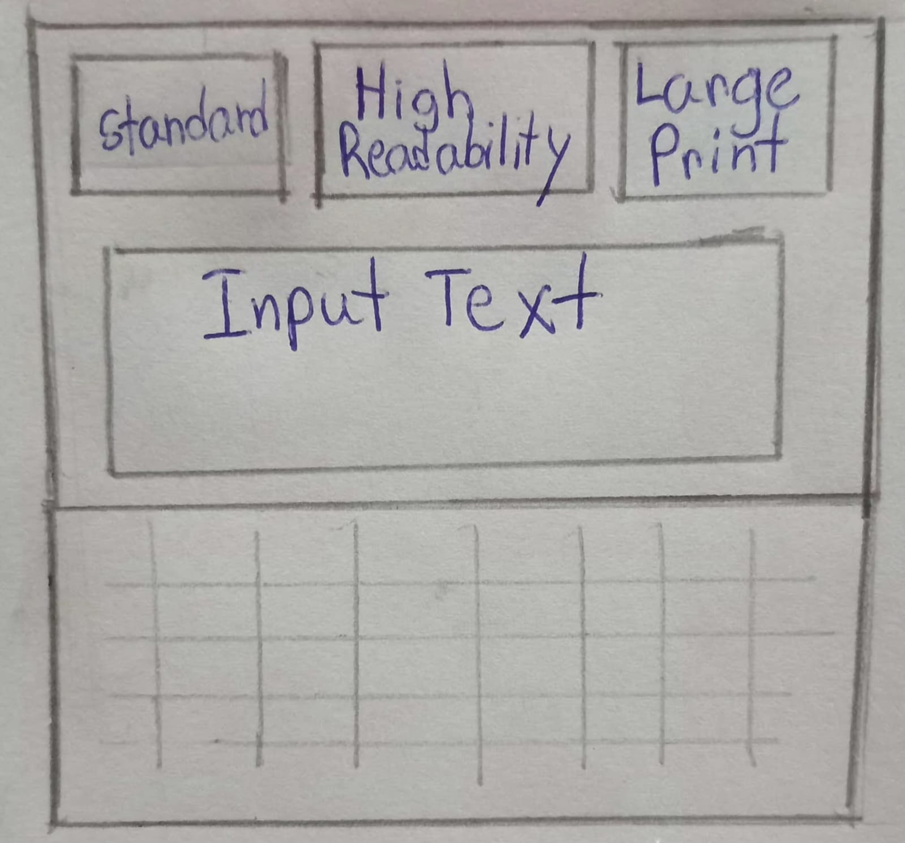
First
Prototype
A lesson-editor prototype for teachers, testing whether they'll use one-click formatting shortcuts instead of their default document style while building content.
A toolbar of three preset buttons. Standard, High Readability, and Large Print sits above an editable lesson document.
Each button shows a live "Aa" preview of its font and spacing before it's clicked. The lesson area is directly editable (click in and type), so a teacher can draft real content and switch presets mid-edit without losing their place or their cursor.

Slide 14
Results
The surprising finding wasn't about the presets themselves but about persistence; several teachers assumed their chosen preset would carry over the next time they opened the same lesson, and were caught off guard that it reset to Standard. This suggests the one-click convenience matters less if teachers have to reapply it every session.
The live "Aa" previews inside each button worked well. Testers could see what "High Readability" or "Large Print" meant before committing, removing the guesswork a text-only label would have caused. Making the lesson document directly editable was also well received; teachers didn't have to switch between an "editing mode" and a "preview mode" to see how a preset would affect their own content, since they could type and toggle in the same view.
“

Slide 15
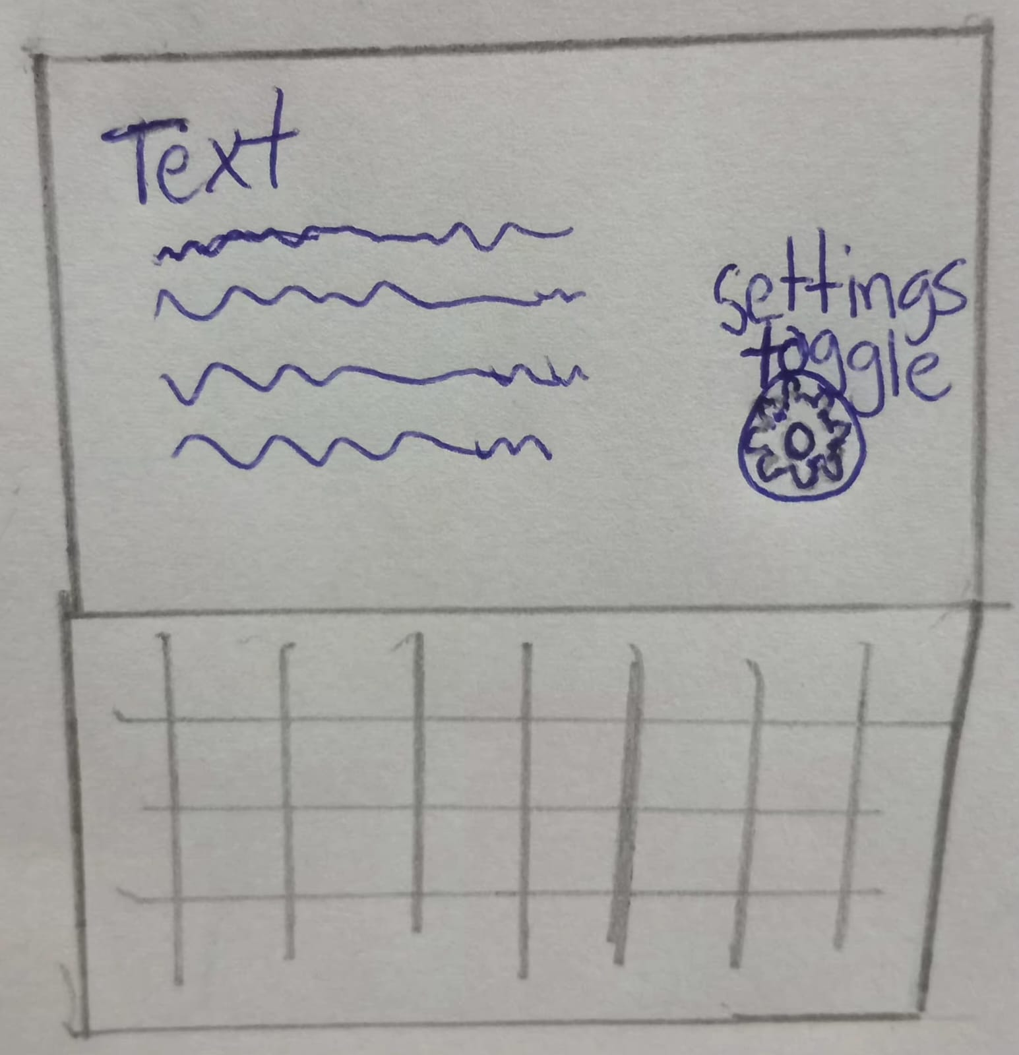
Second
Prototype
Tapping it opens a compact panel with text-size stepping, a three-level spacing control, and a clamped set of five accessible background-color swatches.
An interface made with the perspective of a student with dyslexia in mind. prototype testing whether dyslexic readers prefer adjusting visual settings on the fly over a fixed profile. A small draggable circular handle floats over a sample reading passage, collapsed by default so it doesn't compete with the text.
Dragging and tapping are distinguished by the distance of movement, so repositioning the widget never accidentally opens or closes it.

Slide 16
Results
The surprising finding was that students dealt with the settings that had previously been available. Most of them setting them once early on in a reading session and then hardly touching them again as they progressed page by page, behaving more in a 'set it and go' manner than by making continuous, on-the-fly adjustments, something the prototype was intended to support. This is a significant refutation of the basic assumption, not merely a design issue.
The method of distinguishing between dragging and tapping based on the distance of movement worked as expected, since the students were able to reposition the wheel so that it was out of the way of the text they were reading without by accident causing the panel to open or close. Similarly, the background-color swatches that were held in place proved to be effective, as instead of getting lost in the colour picker which had no limits, the students quickly settled on a tint that seemed comfortable and then returned to reading.
“

Slide 17
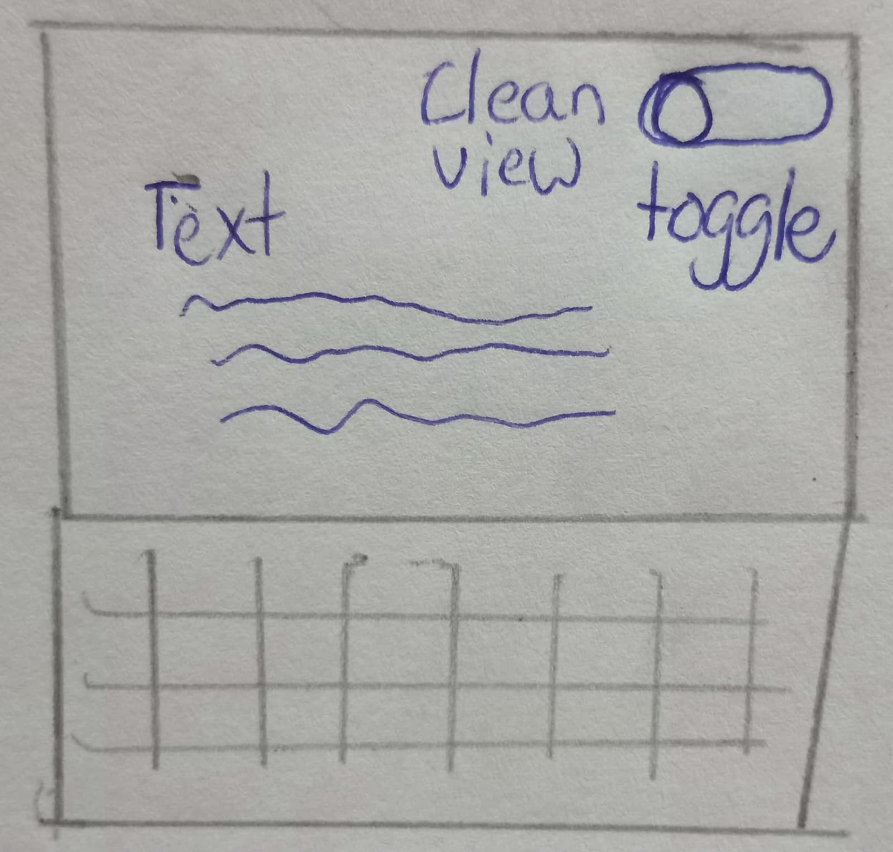
Third
Prototype
A prototype testing whether students receiving messy shared notes will use a one-click reformat instead of reading the original layout as-is.
A top-bar toggle switches a sample set of peer study notes between their raw, unstructured form and a restructured version with headings, bulleted definitions, and a highlighted callout for time-sensitive content.
The toggle is non-destructive; it swaps between two existing versions rather than rewriting the document, so the original is always one click away.

Slide 18
Results
The main issue wasn't the toggle but rather trust: some students said they would be reluctant to rely on an automatically cleaned version when preparing for exams unless they could quickly check it against the original, even though the unaltered version was only one click away. This shows that the greatest obstacle to adoption is accuracy, not convenience.
The toggle was designed to be non-destructive, that is, it allowed students to switch between the unedited and the cleaned versions without altering or losing the original versions of their peers' notes, they felt confident using it. This demonstrated that the reformatting had retained what was important rather than simply flattening it.
“

Slide 19
THANK YOU!

